Slide 1

Department of Computer Engineering
Sequential Logic Design – JK Flip
1

Slide 2
Points covered
Department of Computer Engineering
Introduction
JK Flip flop
2

Slide 3
Department Vision & Mission
Department of Computer Engineering
Vision
Achieve academic excellence through education in computing, to create intellectual manpower to explore professional, higher educational and social opportunities.
Mission
To impart learning by educating students with conceptual knowledge and hands on practices using modern tools, FOSS technologies and competency skills there by igniting the young minds for innovative thinking, professional expertise and research.

Slide 4
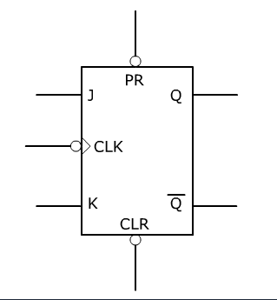
JK FF
Department of Computer Engineering
Used to avoid race condition which does occur in SR FF
It has 2 inputs named J & K.
It has two outputs Q & Q’.
One Clock signal.
2 Asynchronous inputs PR & CLR
Symbol of JK -

Slide 5
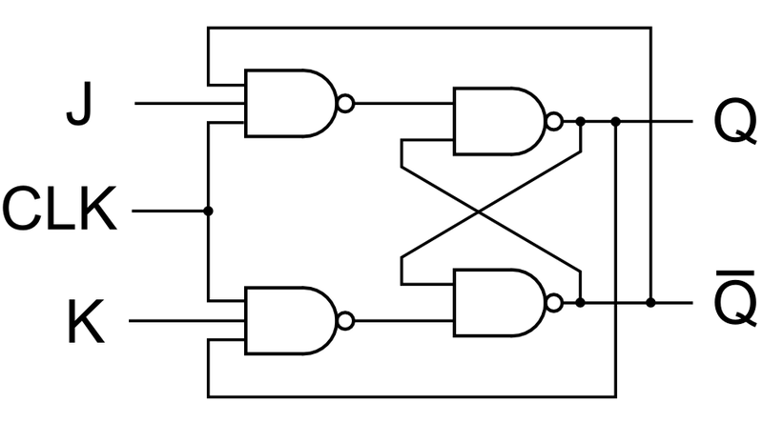
Department of Computer Engineering
JK FF Operation
The 4 modes of operation are: hold, set, reset, toggle
Truth Table of JK
J | K | Q | Q’ | Mode
0 | 0 | Q | Q’ | Hold
1 | 0 | 1 | 0 | Sets
0 | 1 | 0 | 1 | Resets
1 | 1 | Q’ | Q | Toggle

Slide 6
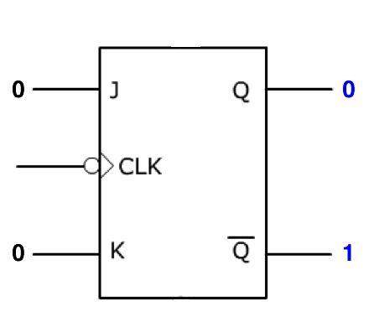
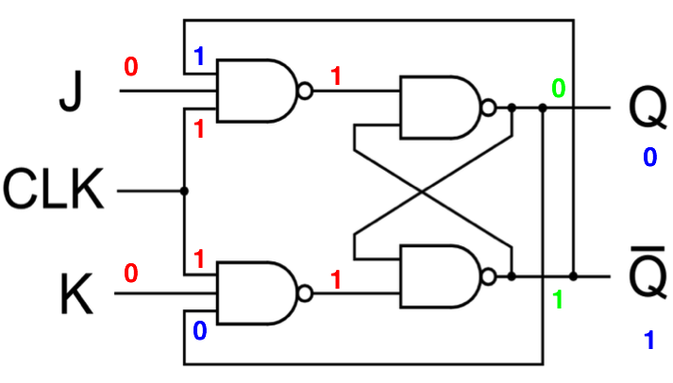
Department of Computer Engineering
Mode of Operation: Hold
Hold: no change in Q.
J | K | Next state Q | Q’ | Orig. Q | Orig. Q’
0 | 0 | 0 | 1 | 0 | 1

Slide 7
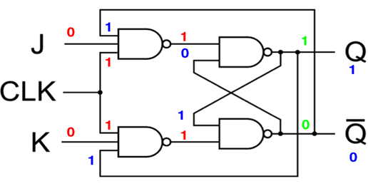
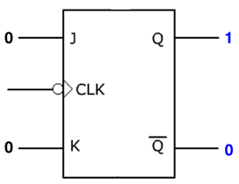
Department of Computer Engineering
Mode of Operation: Hold
Hold: no change in Q.
J | K | Next state Q | Q’ | Orig. Q | Orig. Q’
0 | 0 | 1 | 0 | 1 | 0

Slide 8
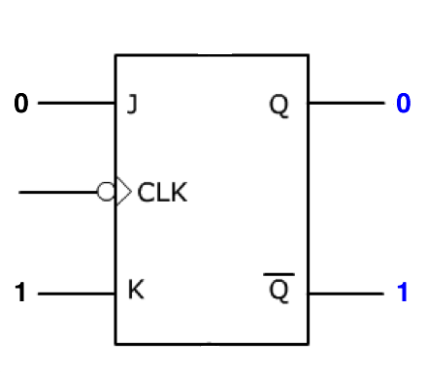
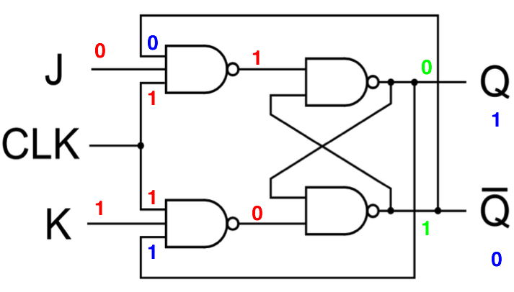
Department of Computer Engineering
Mode of Operation: Reset
Reset: Q = 0.
J | K | Q | Q’ | Orig. Q | Orig. Q’
0 | 1 | 0 | 1 | 1 | 0

Slide 9
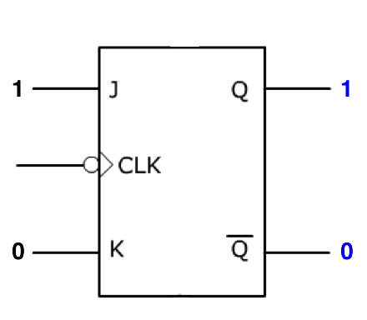
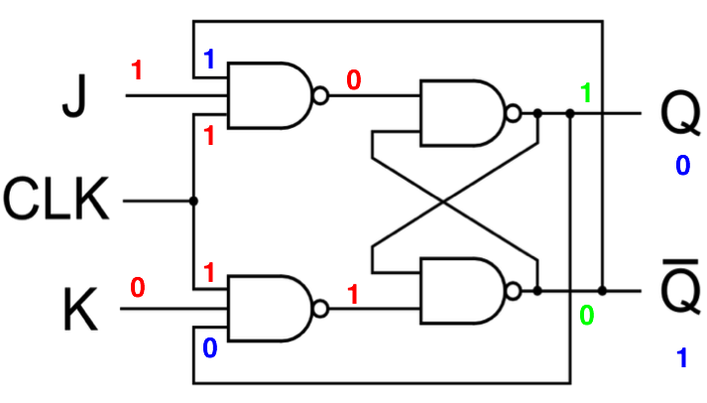
Department of Computer Engineering
Mode of Operation: Set
Set: Q = 1.
J | K | Next State Q | Q’ | Orig. Q | Orig. Q’
1 | 0 | 1 | 0 | 0 | 1

Slide 10
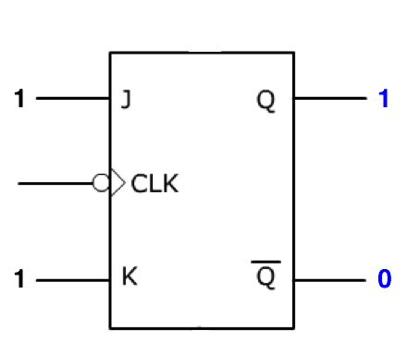
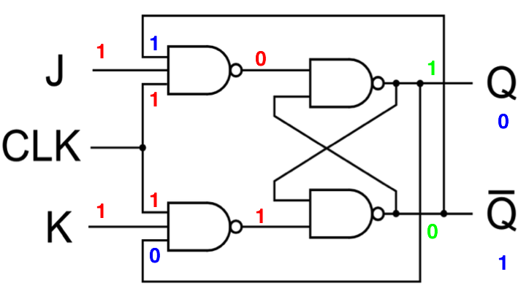
Department of Computer Engineering
Mode of Operation: Toggle
Toggle: Q = Q’.
J | K | Q | Q’ | Orig. Q | Orig. Q’
1 | 1 | 1 | 0 | 0 | 1

Slide 11
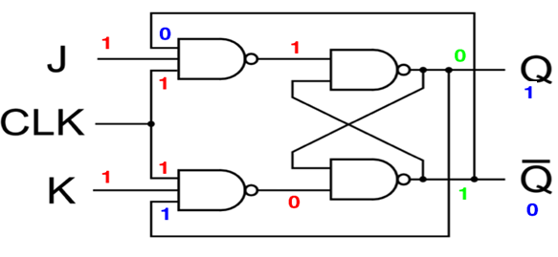
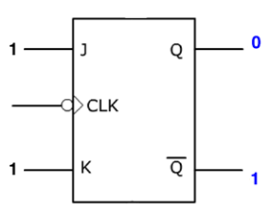
Department of Computer Engineering
Mode of Operation: Toggle
Toggle: Q = Q’.
J | K | Q | Q’ | Orig. Q | Orig. Q’
1 | 1 | 0 | 1 | 1 | 0

Slide 12
Department of Computer Engineering
JK FF Operation
The 4 modes of operation are: hold, set, reset, toggle
Truth Table of JK
J | K | Q | Q’ | Mode
0 | 0 | Q | Q’ | Hold
1 | 0 | 1 | 0 | Sets
0 | 1 | 0 | 1 | Resets
1 | 1 | Q’ | Q | Toggle

Slide 13
Race Around Condition
Department of Computer Engineering
When J=K=1, then race around condition occurs
It occurs, when the time period of the clock pulse (pulse width) is greater than the propagation delay of the flip flop. Due to that output changes or toggles in a single clock period.
Propagation delay is the speed of operation of circuit.
We cant make clock pulse smaller than propagation delay, so to avoid it two options:
Master slave JK FF
Edge triggered JK FF

Slide 14
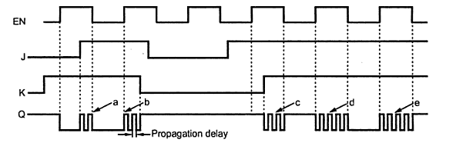
Department of Computer Engineering
Race Around Condition

Slide 15
Department of Computer Engineering
Inputs: PR and CLR
A low at the PR input sets Q = 1
A low at the CLR input sets Q = 0

Slide 16
Department of Computer Engineering
Preset & Clear
When the power is switched on the state of the circuit is uncertain.(i.e. 0 or 1)
In many application it is desired to initially set or reset the Flip Flop to initial state.
This is accomplished by using direct or asynchronous inputs referred to as preset(Pr) and clear(Cr) inputs.
These inputs may be applied at any time between clock pulses.
They are highest priority inputs.

Slide 17
Master Slave FF
Department of Computer Engineering
The Master-Slave Flip-Flop is basically two gated SR flip-flops connected together in a series configuration with the slave having an inverted clock pulse.
The outputs from Q and Q’ from the “Slave” flip-flop are fed back to the inputs of the “Master” with the outputs of the “Master” flip flop being connected to the two inputs of the “Slave” flip flop.
When clock is ‘high’, master SR latch will lock the input conditions and as clock is inverted to slave , slave SR latch will not toggles.
When clock goes low, the outputs from master FF are latched and any additional changes to its inputs are ignored. Now gated slave FF are now responds.

Slide 18
Master Slave FF
Department of Computer Engineering
On low to high transitions of clock pulse the inputs of master FF are fed through to the gated inputs of slave FF and on High-to-Low” transition the same inputs are reflected on the output of the “slave” making this type of flip flop edge or pulse-triggered.
Then, the circuit accepts input data when the clock signal is “HIGH”, and passes the data to the output on the falling-edge of the clock signal.
Master-Slave JK Flip flop is a “Synchronous” device as it only passes data with the timing of the clock signal.

Slide 19
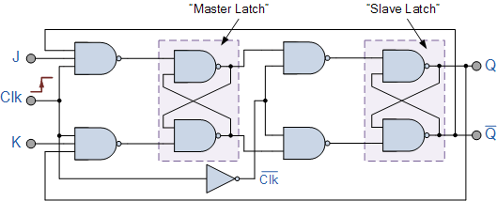
Department of Computer Engineering
Master Slave FF

Slide 20
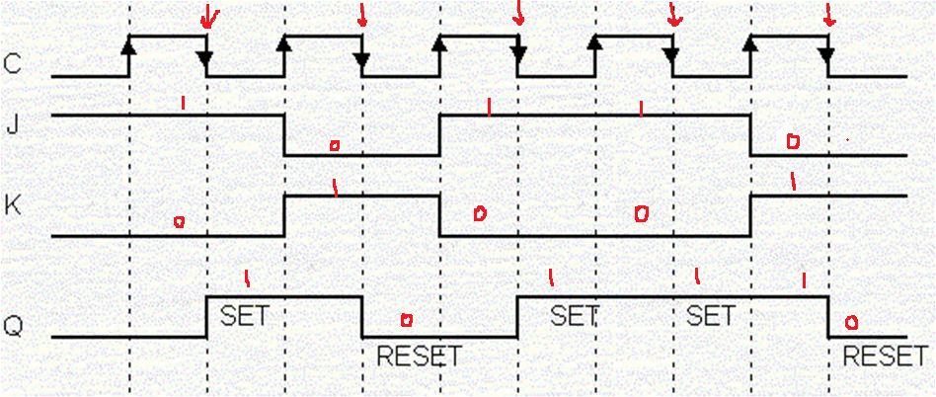
Department of Computer Engineering
Input Output waveform of Mater Slave flip flop

Slide 21
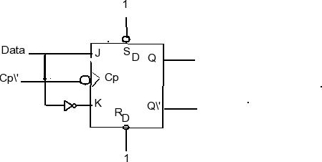
Department of Computer Engineering
D-Type Flip Flop
D – means Delay. The Q output always takes on the state of the D input at the moment of a rising clock edge.
The output takes the value of the D input or Data input, and Delays it by one clock count.
Truth Table
D | Q
0 | 0
1 | 1

Slide 22
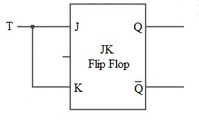
Department of Computer Engineering
T -Type Flip Flop (Toggle)
In J K Flip Flop , if J=K, the resulting Flip flop is referred to as a T- type Flip Flop.
Pr
T | Q
0 | Q
1 | Q’
Clk
Cr

Slide 23
Department of Computer Engineering
Thank you

